Slide 1
22 Years of LiveCode and Counting...
The Coders’ Swiss-Army-Knife
(it’s got lots of widgets, cuts any project down to size and stays sharp for years!)
Peter Reid
1

Slide 2
Types of Applications
Demonstrators
Simulations:
prototypes
interactive mock-ups
Document generation
Training Courses
Games
Ad hoc tools
Data:
capture
conversion
analysis
manipulation
aggregation
display
2

Slide 3
Timeline
2000-10 - 2007-12 Pipe2Tab
(MetaCard, Revolution)
2016-06 – current
SpeedyPlayer
(LiveCode)
2004-03 - 2008-04
AssessmentCapture
(Revolution)
2000-12 - 2013-01
eCaseFile
(MetaCard, Revolution,
LiveCode)
2015-08 – current
LA-ICP-MS DataTool
(LiveCode)
1998-04
NHSnet
(MetaCard)
1999-12
Xmas99 (MetaCard)
2001-04 - 2001-12
GetCartooning (Revolution)
2005-05
ModuleFormsProc
(Revolution)
2015-10
LA-ICP-MS RDP
(LiveCode)
1999
2000
2001
2002
2003
2004
2005
2006
2007
2008
2009
2010
2011
2012
2013
2014
2015
1998
2016
1999-10
eZoka (MetaCard
$995)
2002-04
PAD Data Extractor
(Revolution)
2005-01 - 2009-04
CourseAnalyser
(Revolution)
2011-02
HA_Auditor
(LiveCode)
2014-12 – current
CertificateMaker
(LiveCode)
2000-12 BombayCo (MetaCard)
2005-04
AddrBook Exporter
(Revolution)
2011-04
HA Answers Converter
(LiveCode)
2014-07 - current
LA-ICP-MS DataMerger
(LiveCode)
2000-09
Coal-Burner
(MetaCard)
2011-04
FormsProc
(LiveCode)
2015-09 – current
Furniture DataTool
(LiveCode)

Slide 4
Timeline continued...
2021-04
TowersOfHanoi
(LiveCode)
2018-08
MyCoins
(LiveCode)
2020-10
MeSyProg
(LiveCode)
2018-10
GridComms
(LiveCode)
2021-01
Cu3a EventBookings
(LiveCode)
2017-03
ColourPicker
(LiveCode)
2015-08 – current
LA-ICP-MS ImageTool
(LiveCode)
2017
2018
2019
2020
2021
2016
2022
2000...
AssortedUtils
(LiveCode)
2018-04
AphTrainer
(LiveCode)
2021-03
FastFind
(LiveCode)
2017-09
ICP-MS TuneSim
(LiveCode)
2021-03
CalendarMaker
(LiveCode)
2018-06
BingoBalls
(LiveCode)

Slide 5
LiveCode Project Summaries
Timeline
1998 - 2016
Timeline
2017 - 2022

Slide 6
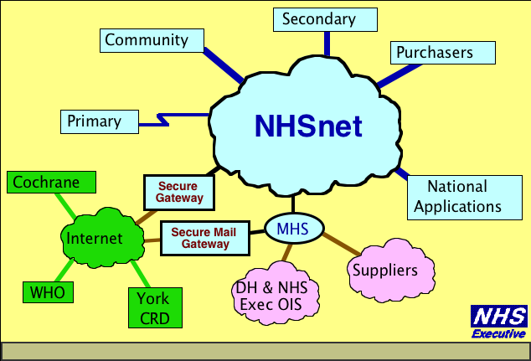
NHSnet (MetaCard, 1998)
Toe in the water
Coming from SuperCard
Mac-only
Uncertain future
Partial build in MetaCard
incomplete but...
...proof of concept
Had to await Mac support
Mac support Oct 1998
and the funds for a MetaCard licence
$995 + $300pa!

Slide 7
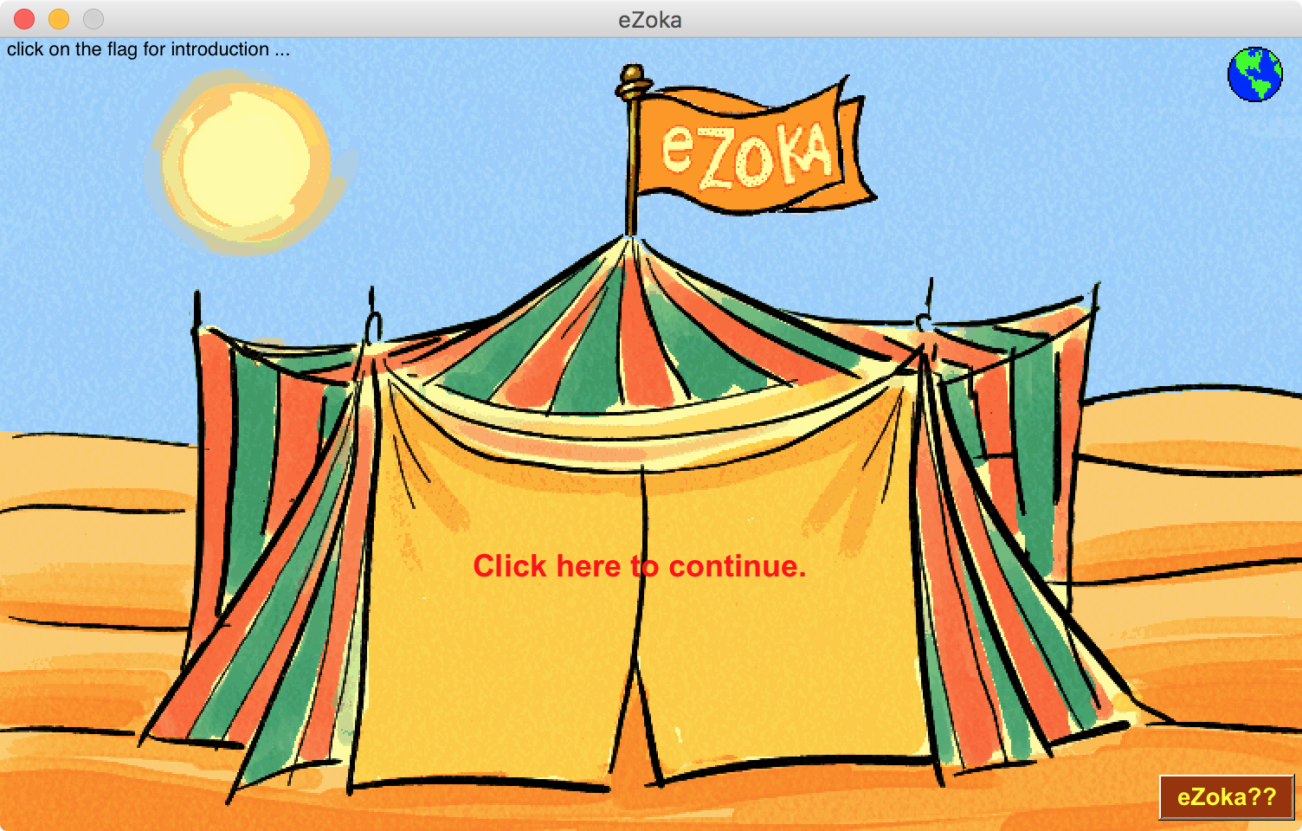
eZoka (MetaCard, 1999)
1st MetaCard licence
$995, 27 Oct 1998
Demo of B2B service
Used to gain funding
Demo still runs today!

Slide 8
Xmas99 (MetaCard, 1999)
Family eXmas Card
Experiment with media

Slide 9
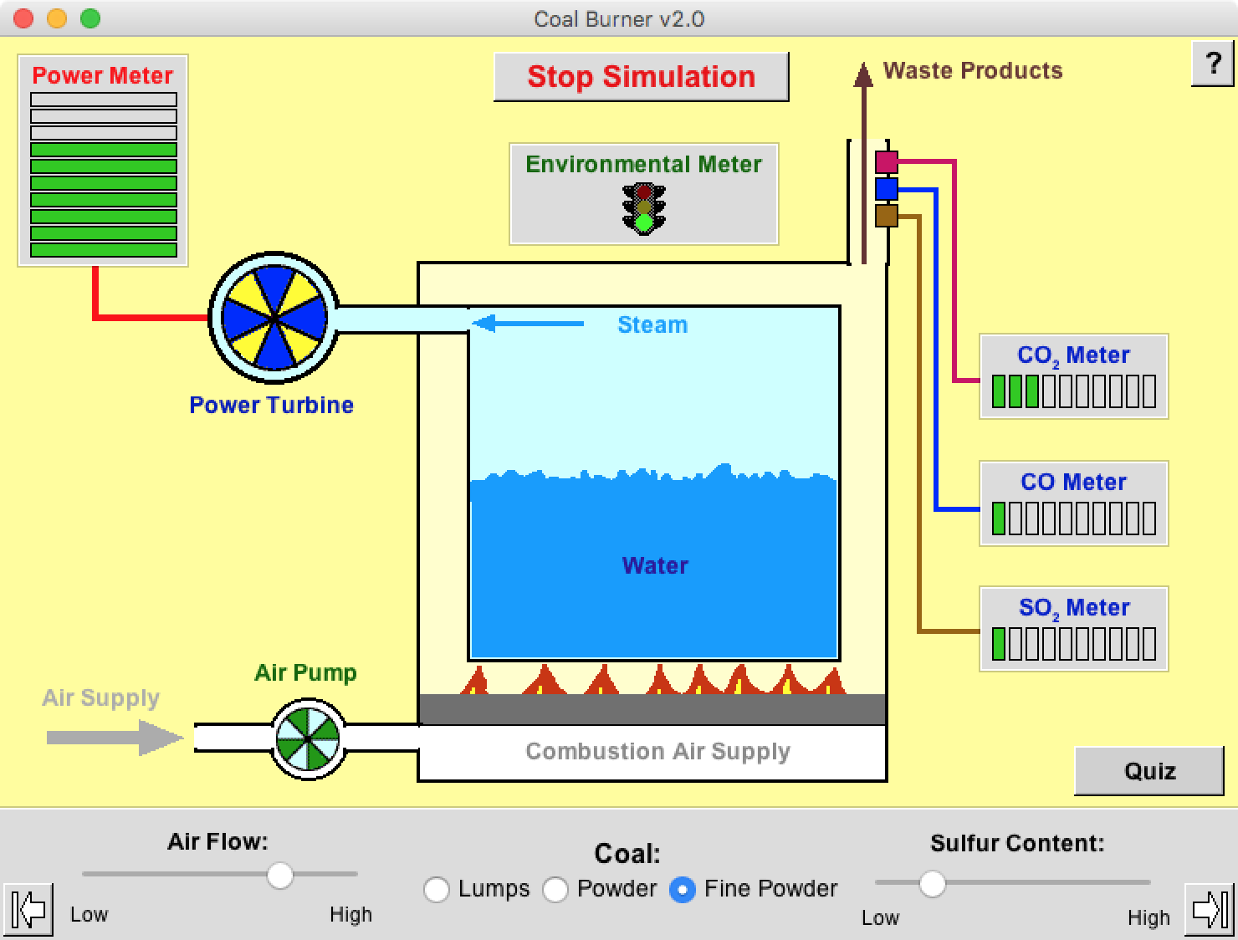
Coal-Burner (MetaCard, 2000)
Simulation of Coal Power Station
for son’s school project
Adjustable animation
Quiz
Parameter-driven

Slide 10
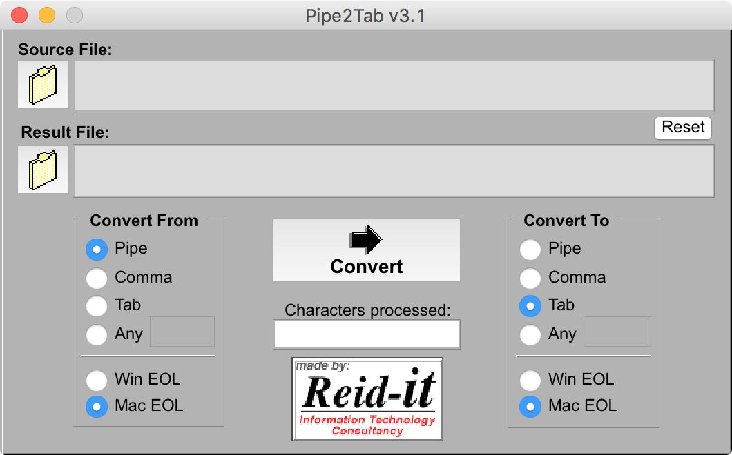
Pipe2Tab (MetaCard, Revolution, 2000-2007)
Conversion of separators in exported text files
Used to transfer data between different databases etc.

Slide 11
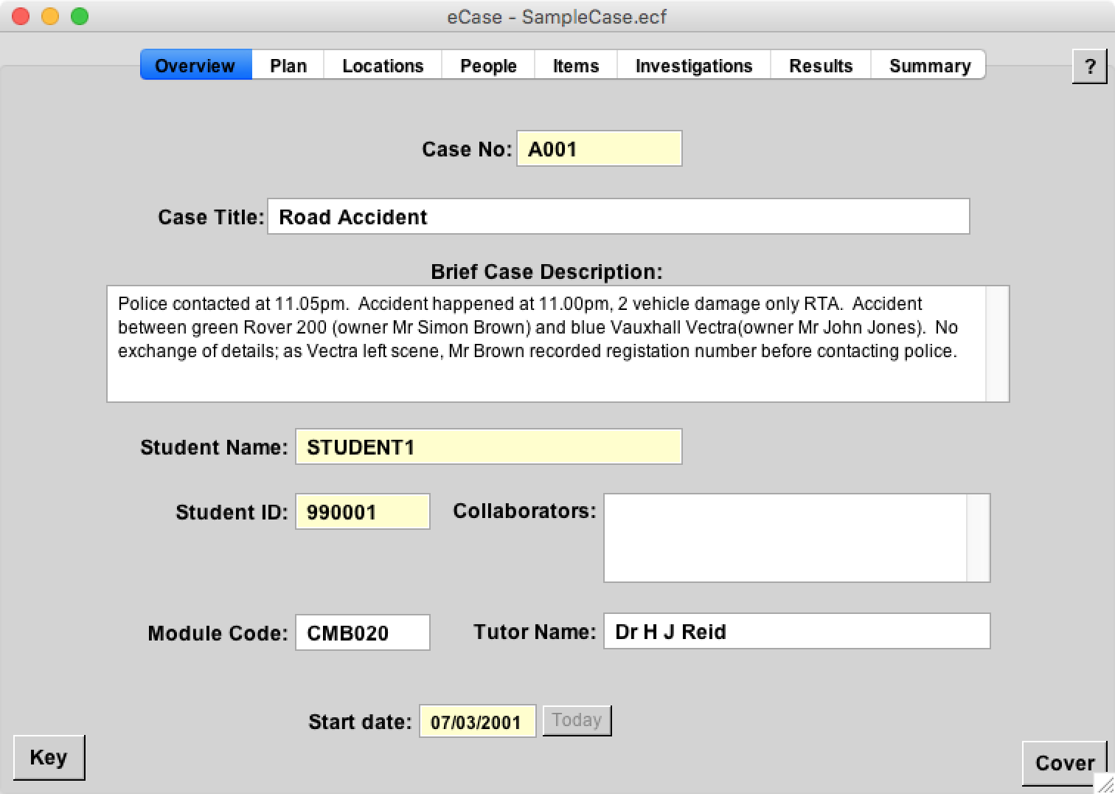
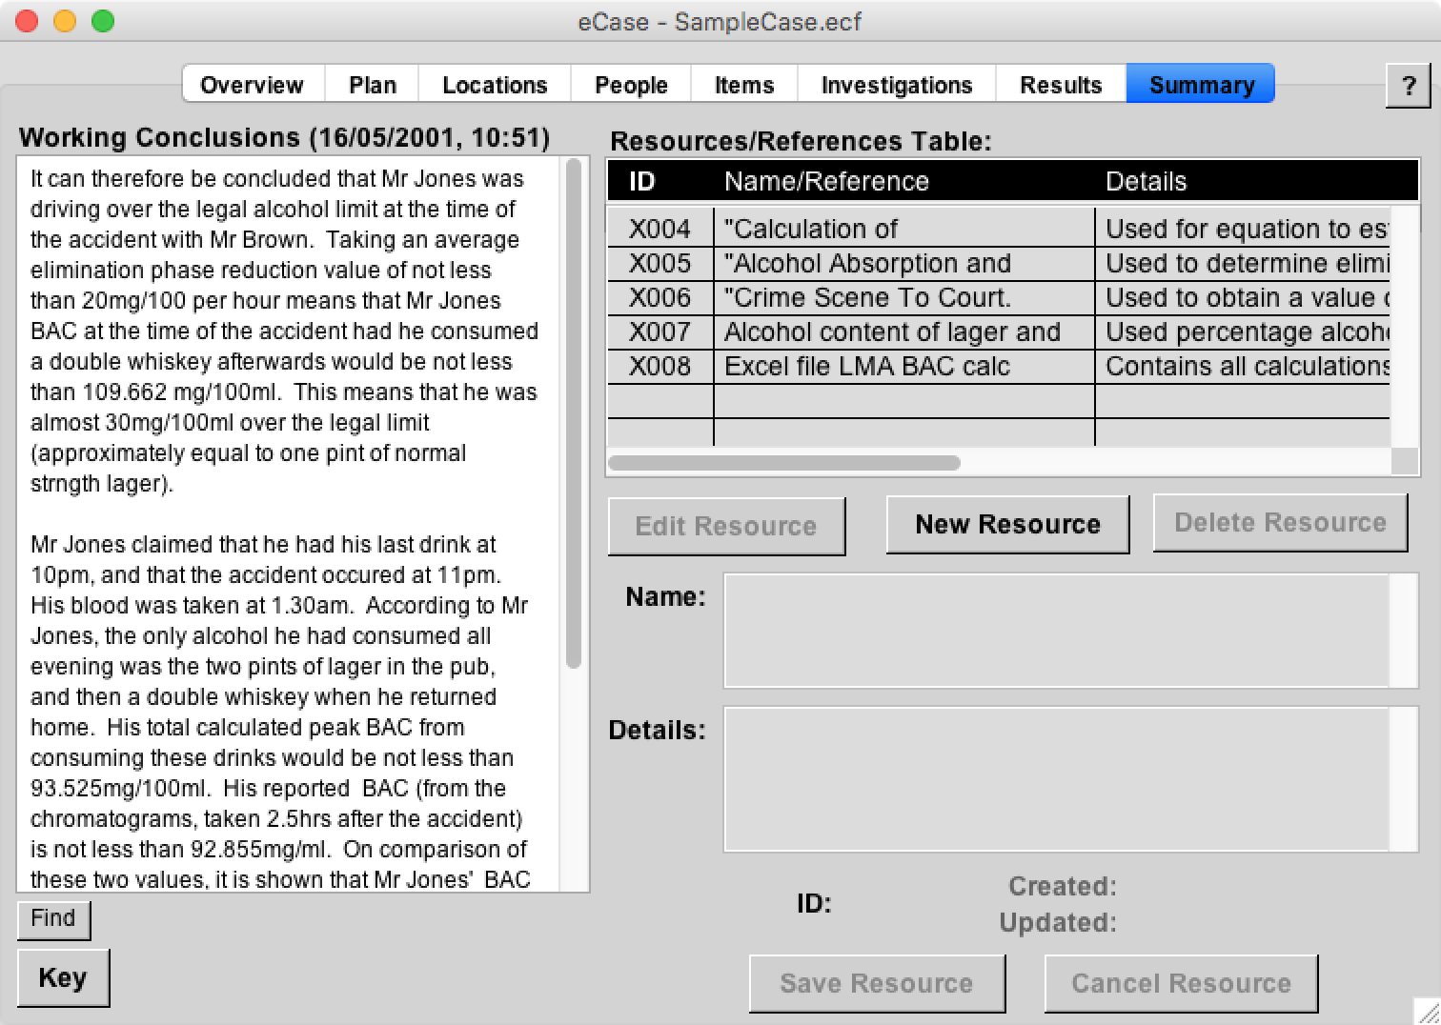
eCaseFile (MetaCard, Revolution,LiveCode, 2000-2013)
Electronic Case File for forensic examinations
Student projects, in use until 2019
Time/date stamped, students can’t ‘cheat’

Slide 12
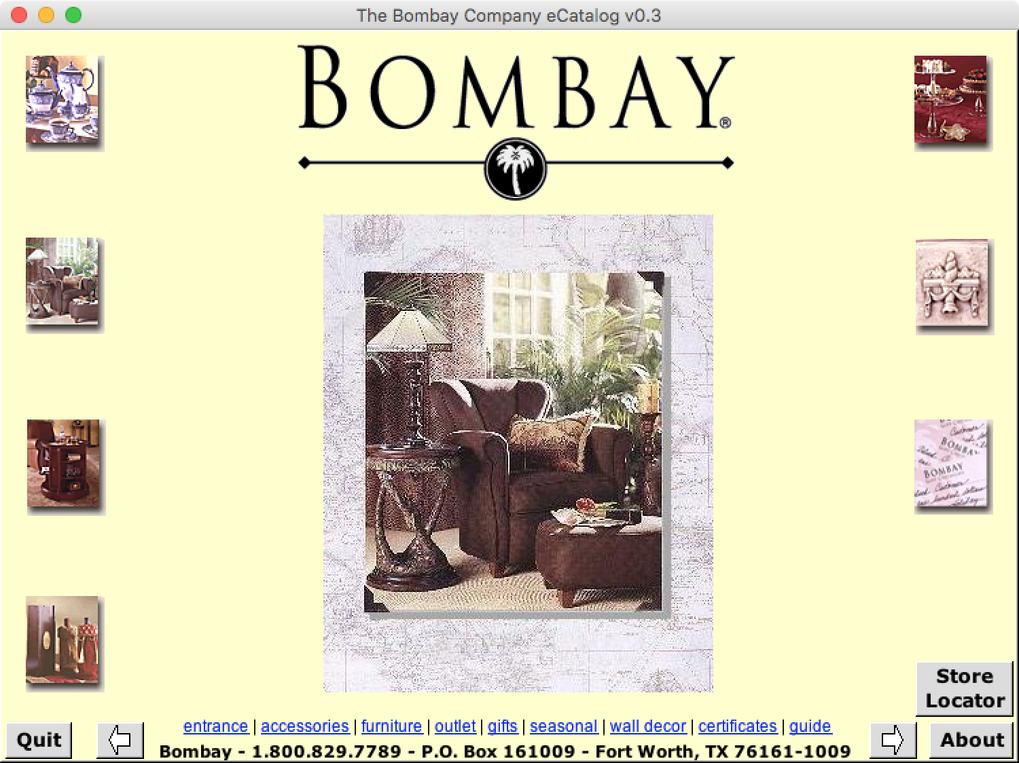
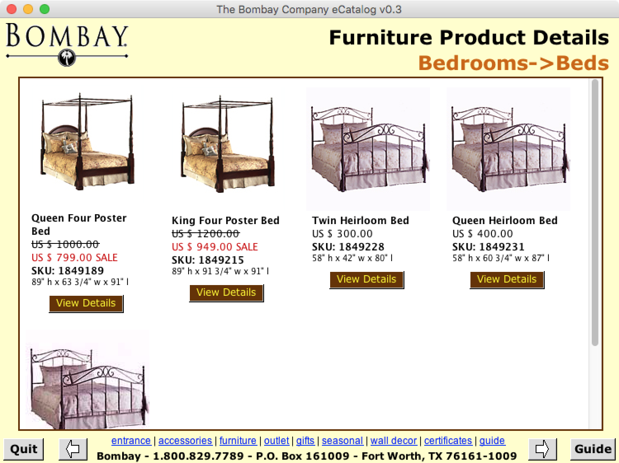
BombayCo (MetaCard, 2000)
Mock-up eCatalogue for distribution on CD
External data-driven

Slide 13
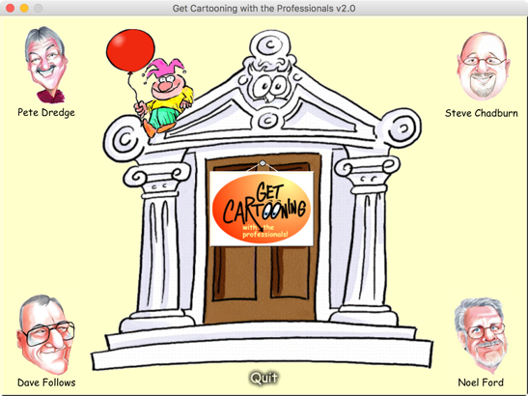
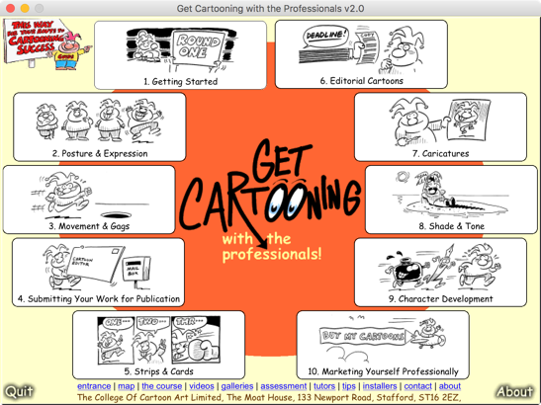
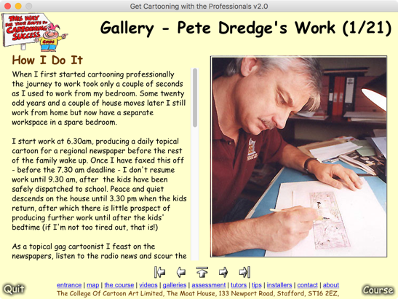
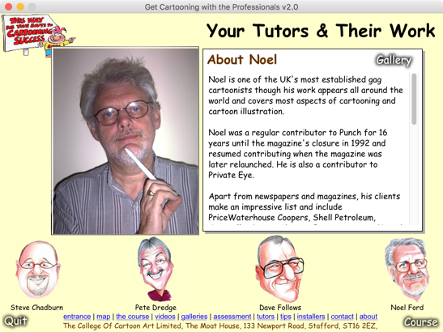
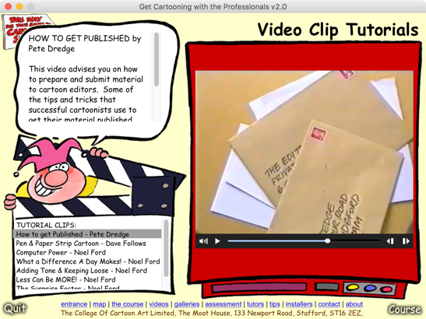
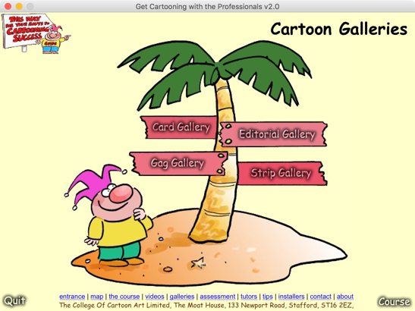
GetCartooning (Revolution, 2001)
CD training course from top UK professional cartoonists (based on successful correspondence course)

Slide 14
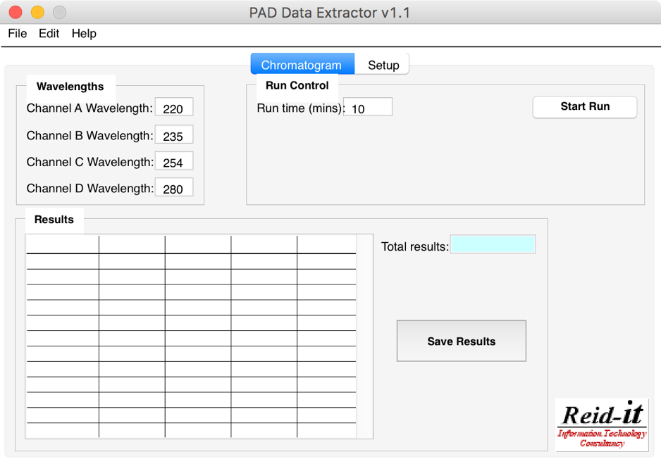
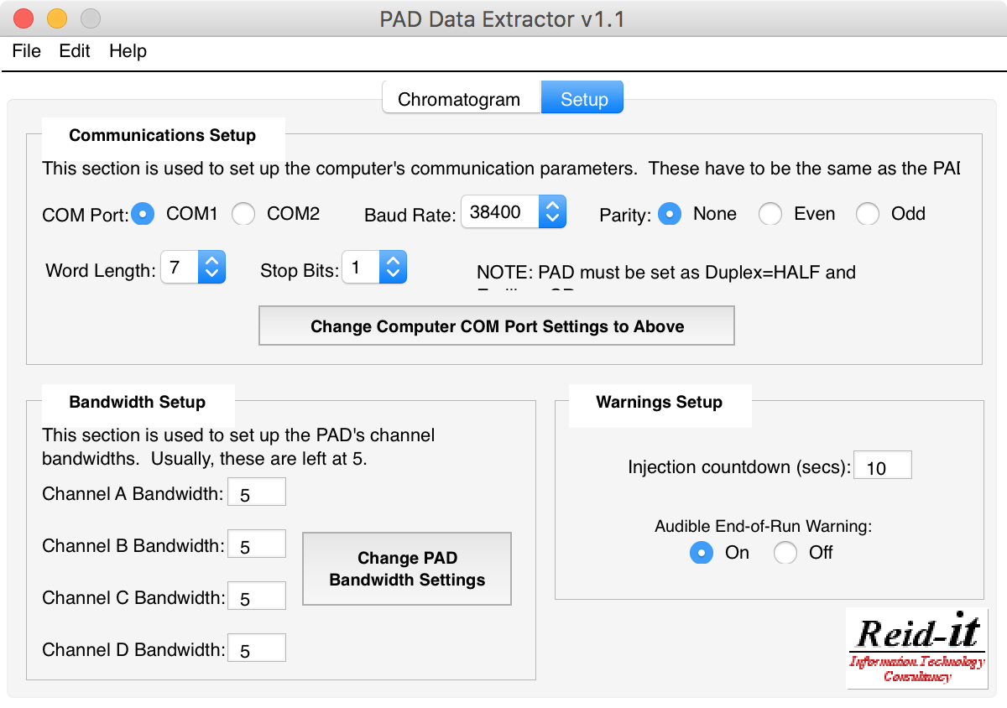
PAD Data Extractor (Revolution, 2002)
Data capture from chemical instrument
gift from industry, but no control software
Export as Excel-compatible tab-delimited text
PAD

Slide 15
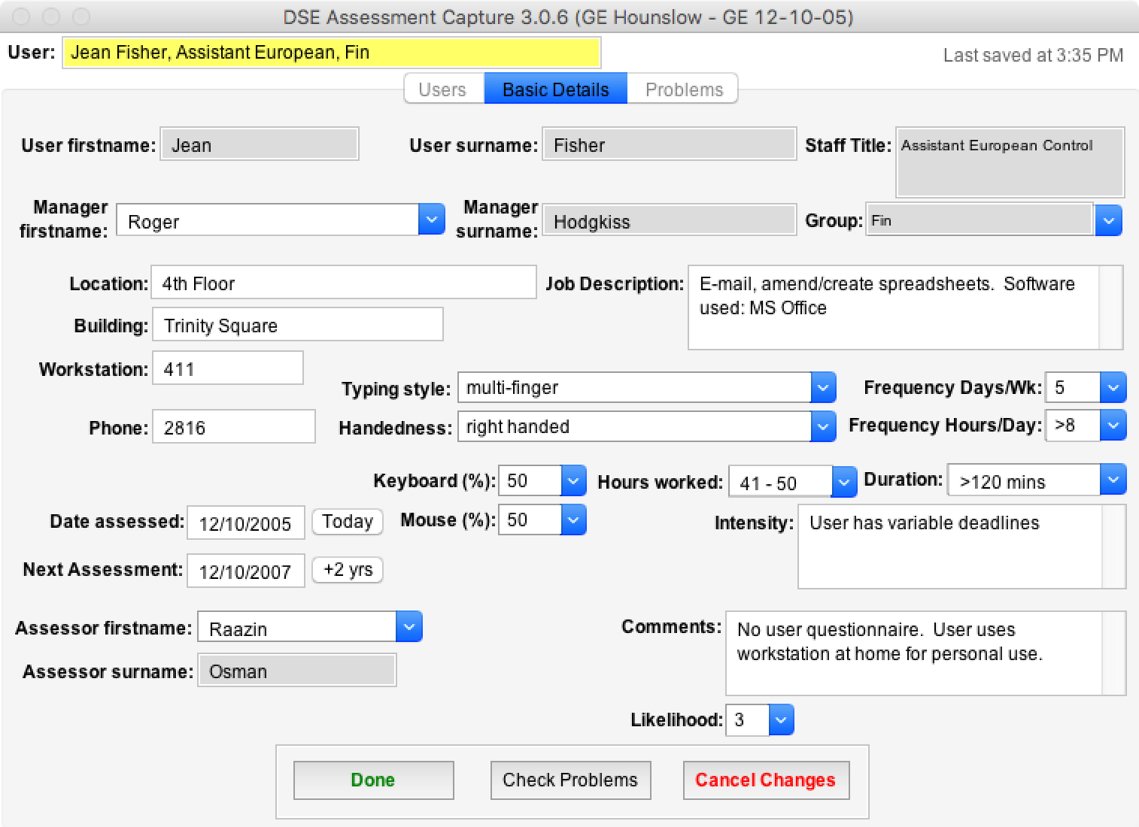
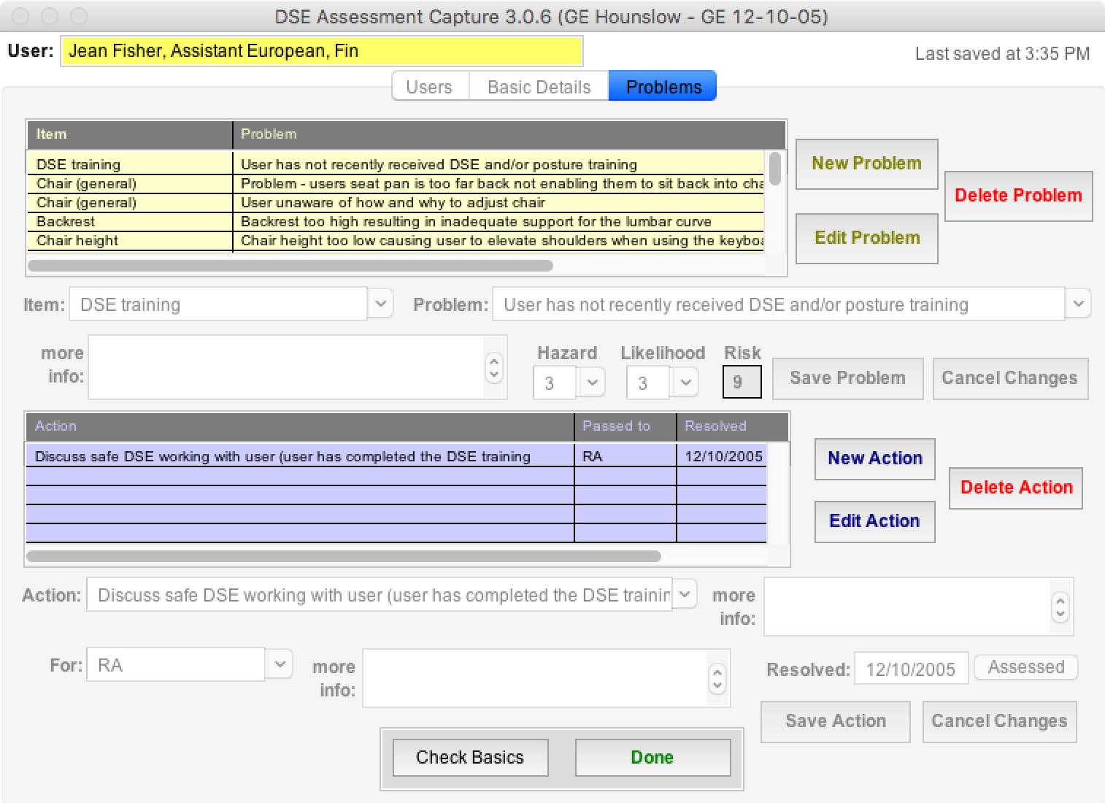
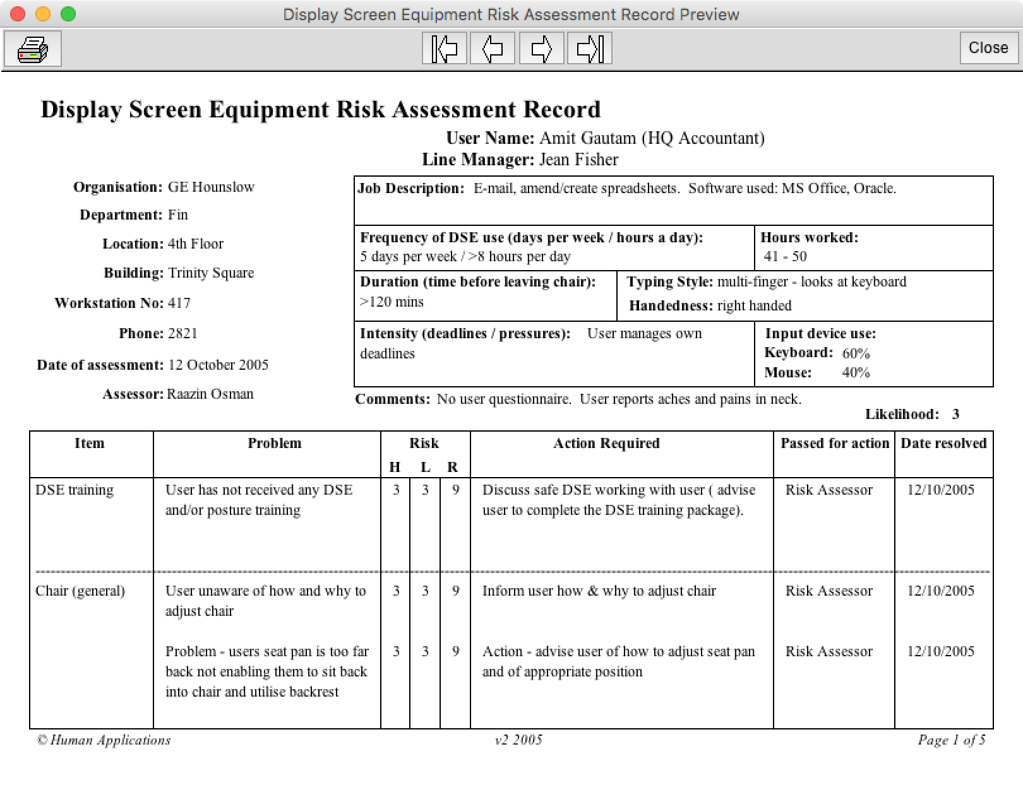
Assessment Capture (Revolution, 2004-2008)
Recording DSE Assessments
Output PDF reports

Slide 16
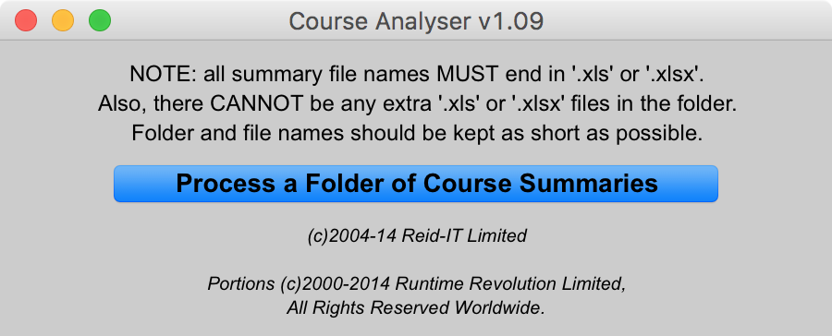
Course Analyser (Revolution, 2005-2009)
Many 100s courses to analyse per year:
required as part of ISO 9000
each course detailed in an Excel spreadsheet
Groups of courses are analysed & summarised in Excel spreadsheets

Slide 17
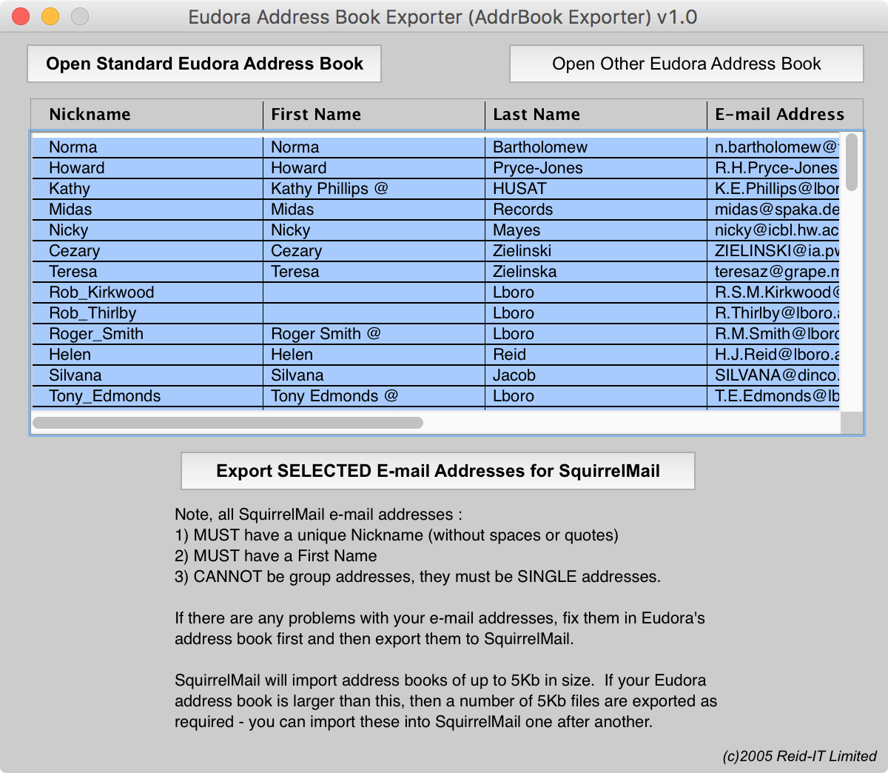
Address Book Exporter (Revolution, 2005)
Conversion tool for transfer of email accounts from Eudora to SquirrelMail
Enabled preservation of email address books

Slide 18
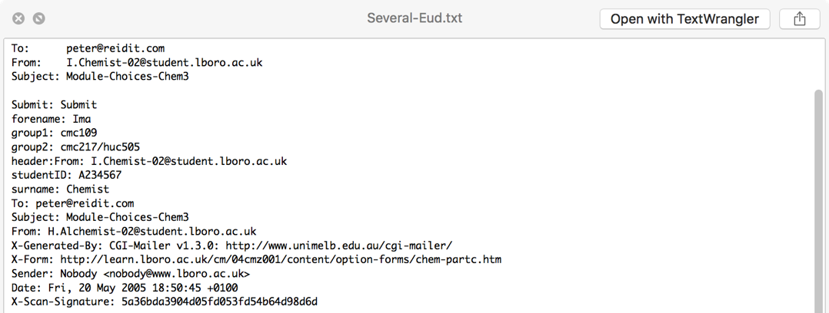
Module Forms Processor (Revolution, 2005)
Process emails containing student module choices
Validating student choices
Summarising choices into Excel spreadsheet

Slide 19
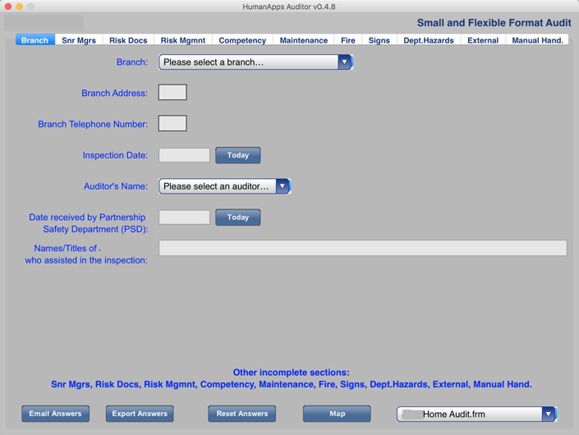
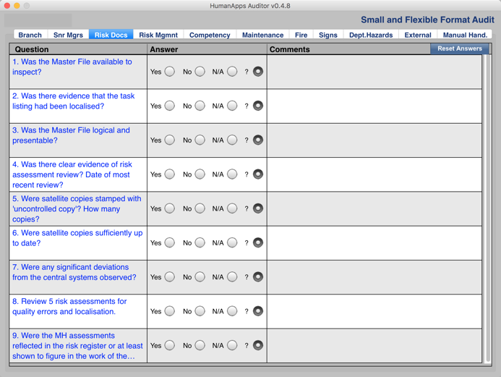
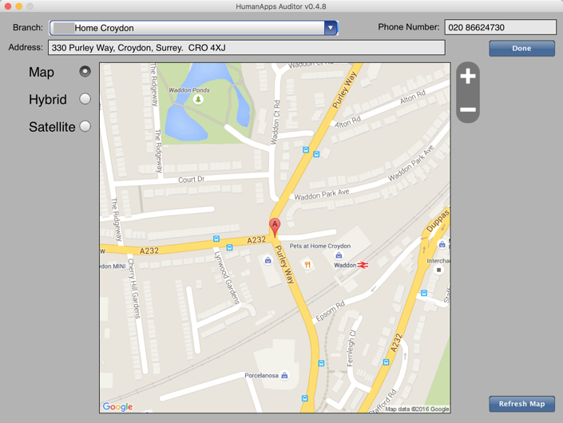
HA Auditor (LiveCode, 2011)
Capture on-site Health & Safety audits, ½ day each
developed for iPad 2 & later, internal use only
validated all inputs, checking for omissions
included look-up of location maps
Enabled 3 years of audits, 350 audits per year
cost was a total of 15 days development effort!
2014: replaced by 3rd party commercial app with on-going support

Slide 20
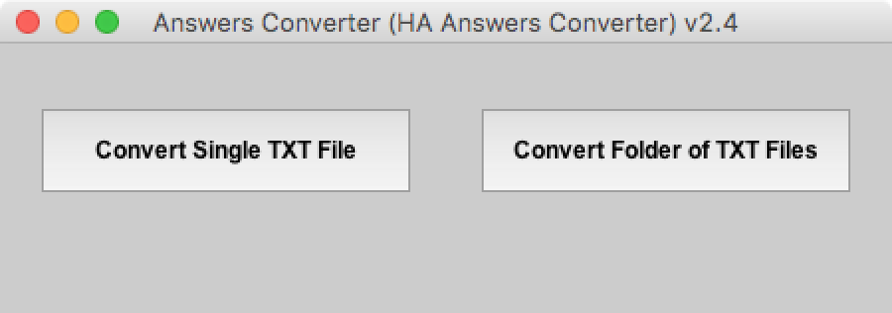
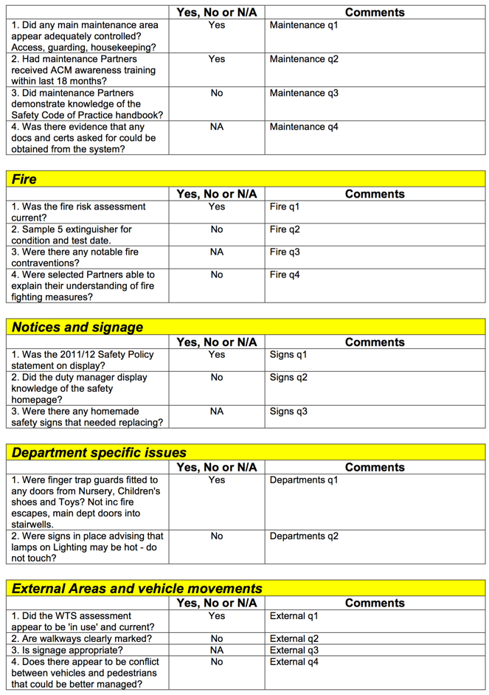
HA Answers Converter (LiveCode, 2011)
Converts Health & Safety data from iPad app
Outputs structured Word DOCX files
Support app for HA_Auditor
Used for 1,000+ audits over 3 years

Slide 21
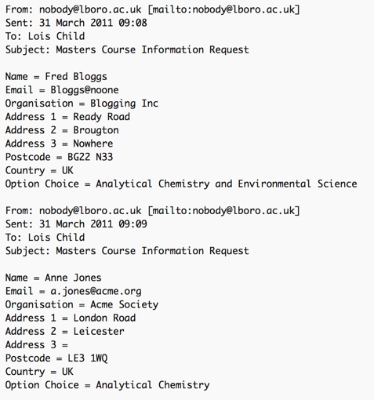
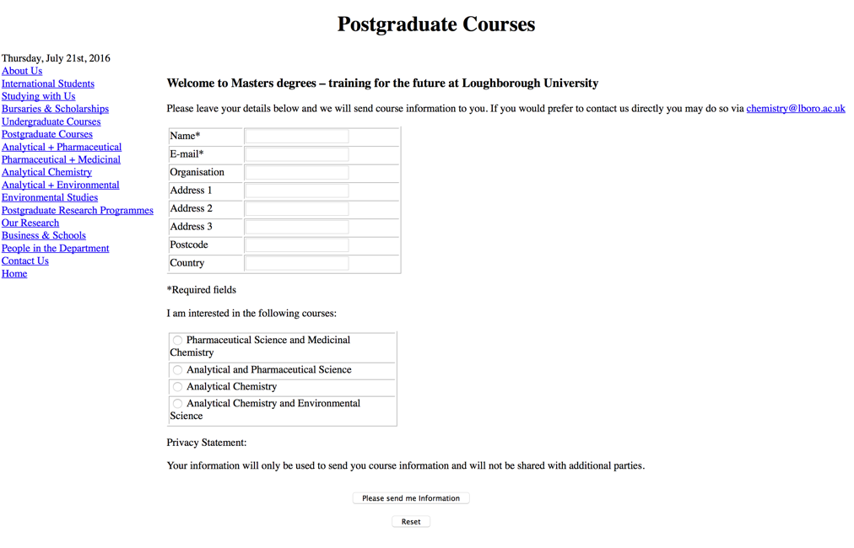
FormsProc (LiveCode, 2011)
Process emails containing student module choices
Validating student choices
Summarising choices into Excel spreadsheet
Based on ModuleFormsProc

Slide 22
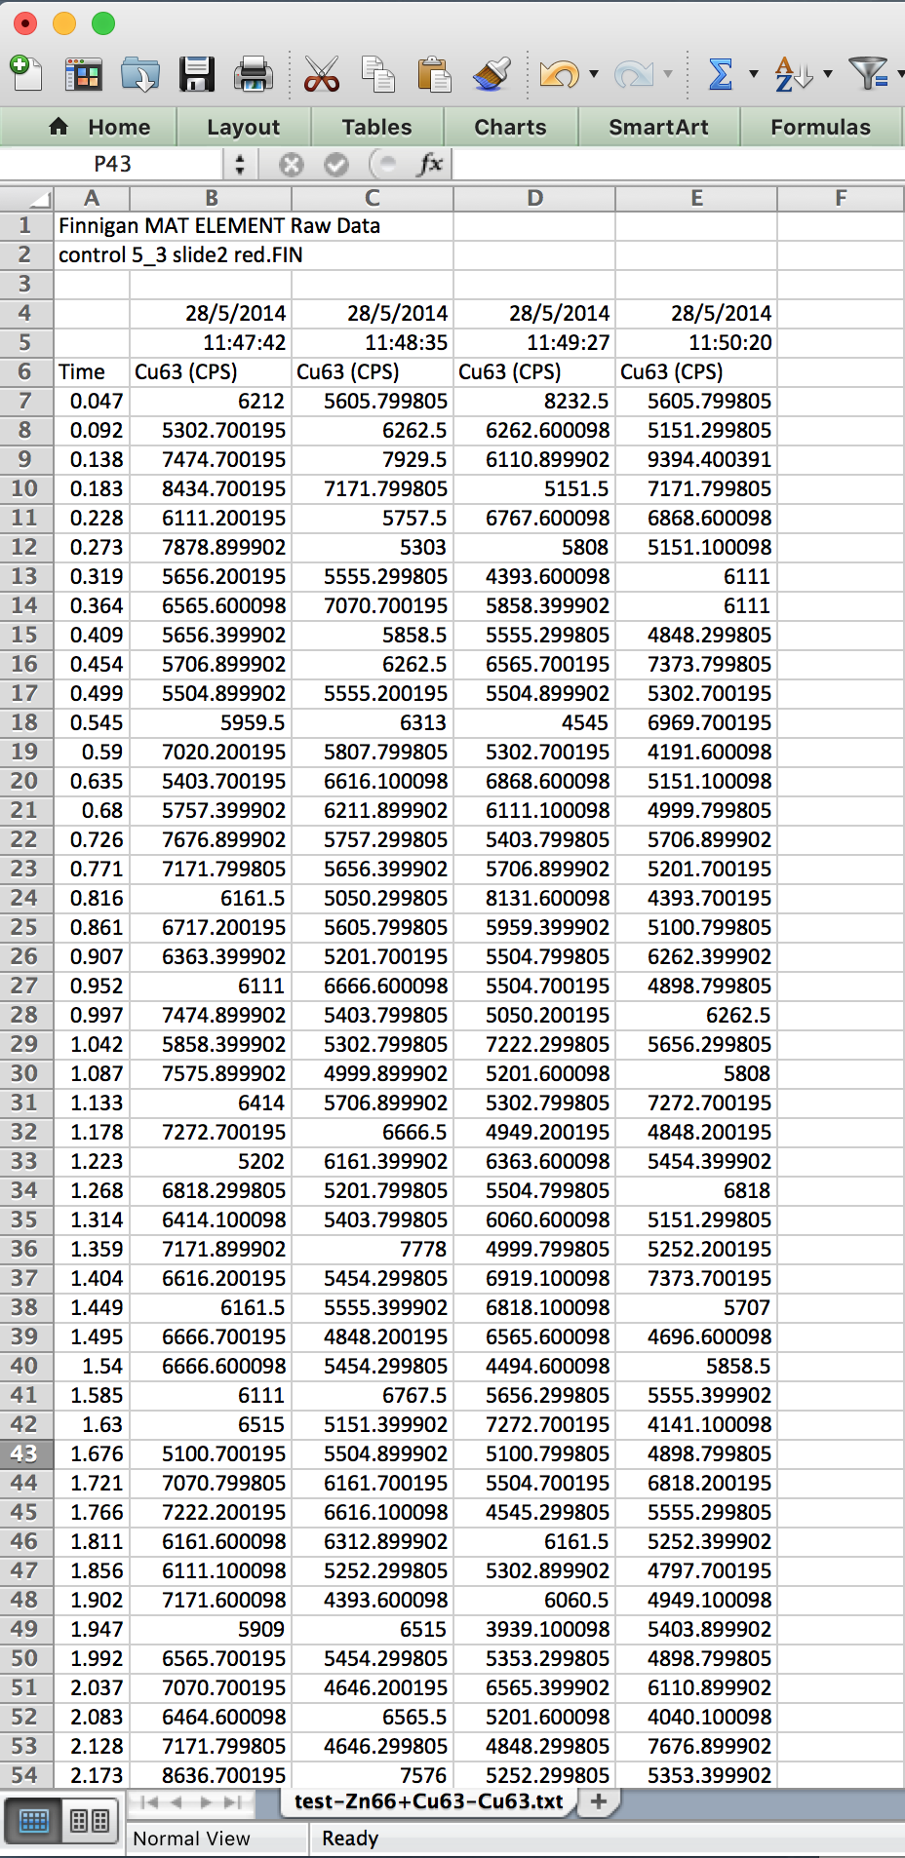
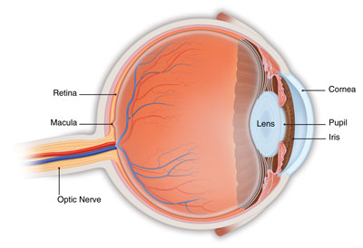
LA-ICP-MS DataMerger (LiveCode, 2014-current)
Retinal tissue samples looking for Zinc & Copper related to AMD (Age-related Macular Degeneration) eye condition
Merges many columns (500 rows each) into a matrix to be imaged separately
Saved lots of time and reduced error from manual copy & paste

Slide 23
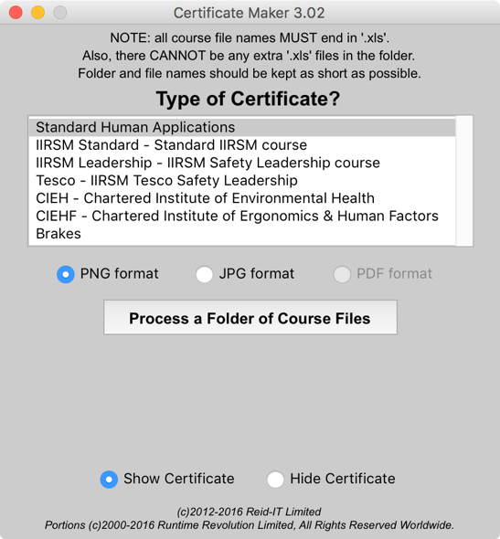
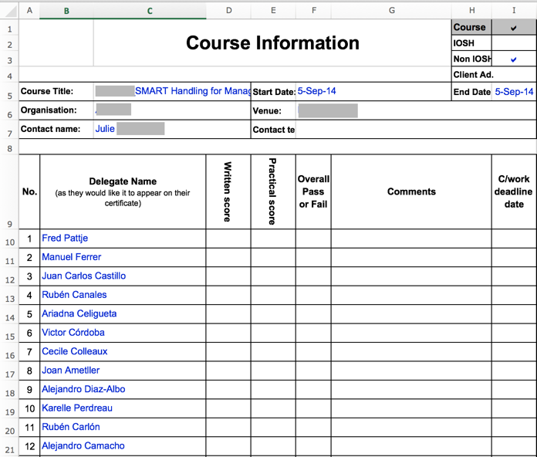
Certificate Maker (LiveCode, 2014-current)
Extracts course attendees from spreadsheets and generates certificates in PNG, JPEG or PDF format
specific requirement to handle names with accents as courses are delivered across Europe
proved to be much faster and less error-prone than previous methods

Slide 24
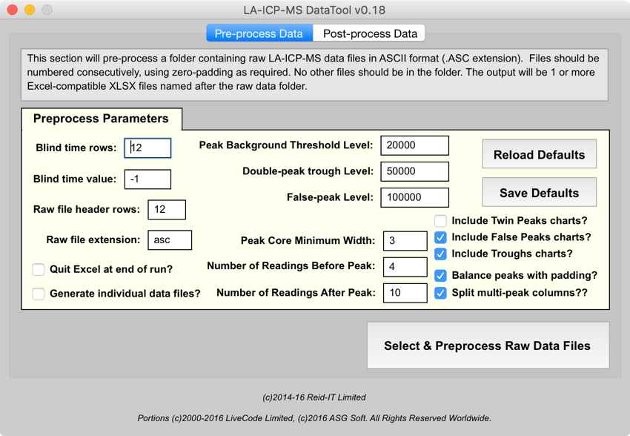
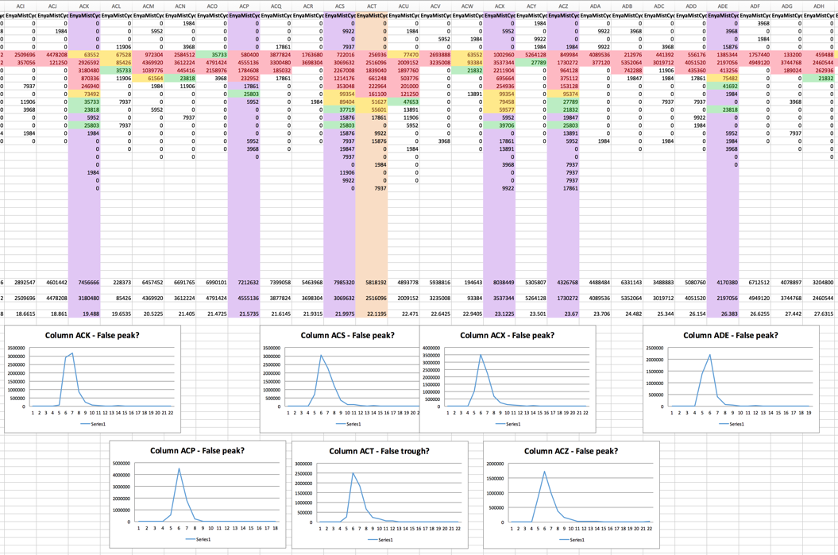
LA-ICP-MS DataTool (LiveCode, 2015-current) 1/2
Vaporised samples produce vast amount of data:
pre-process:
each run output 200 rows by 1900 columns
multiple runs to be merged & peaks identified and graphed (30 rows of 1100 columns)
replaced 6 hours manual processing with 10 mins automated processing

Slide 25
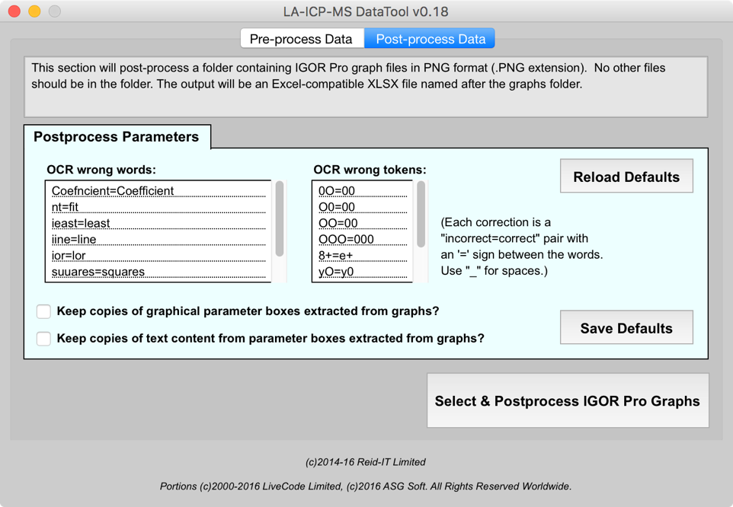
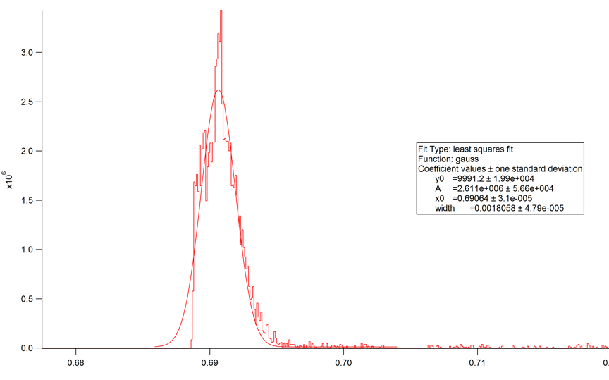
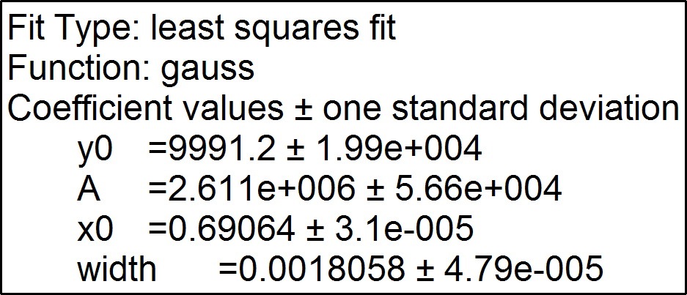
LA-ICP-MS DataTool (LiveCode, 2015-current) 2/2
post-process:
pre-process output fed into curve-fitting app, which generates graphic output
used OCR techniques (Open Source Tesseract-OCR) to locate & extract curve metrics
combined these metrics into spreadsheet with computed products
significantly reduced processing time and error rates by comparison to manual processes

Slide 26
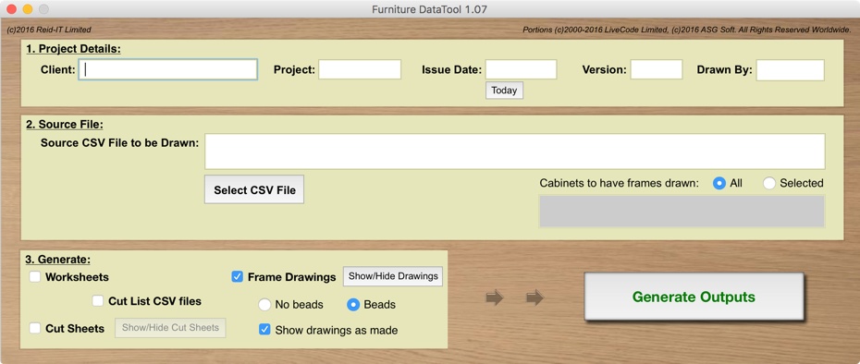
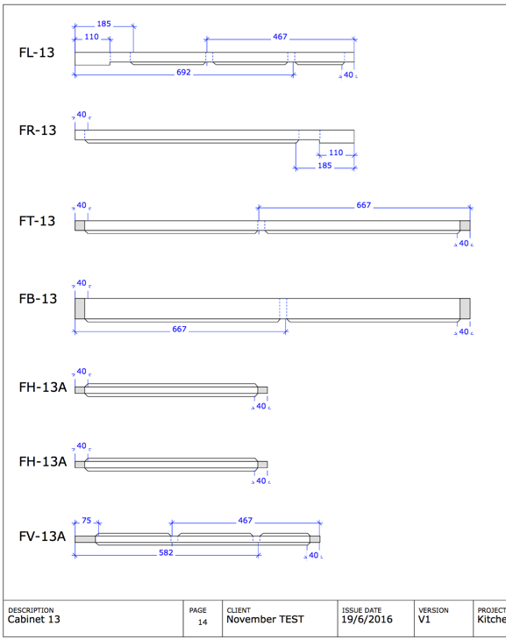
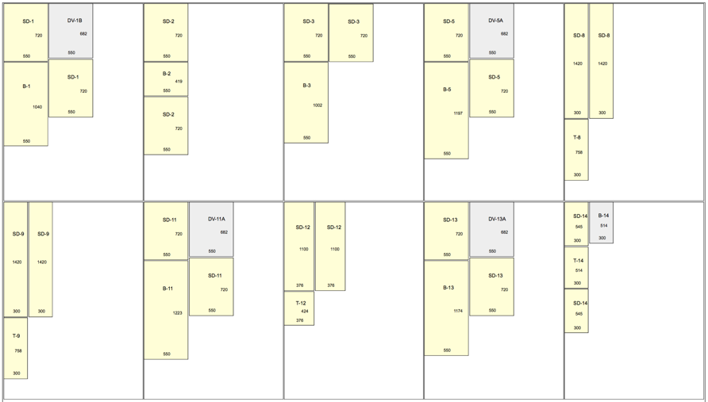
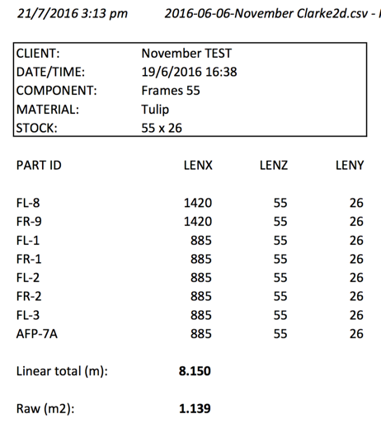
Furniture DataTool (LiveCode, 2015-current)
Takes CSV output from 3D design app & generates:
frame drawings
sheet-cutting drawings
component lists
cut-lists
Output formats:
CSV, XLSX, PDF, SVG
Significant savings:
1-3 days of manual effort per design reduced to 1-2 hours
significantly reduces errors and material wastage

Slide 27
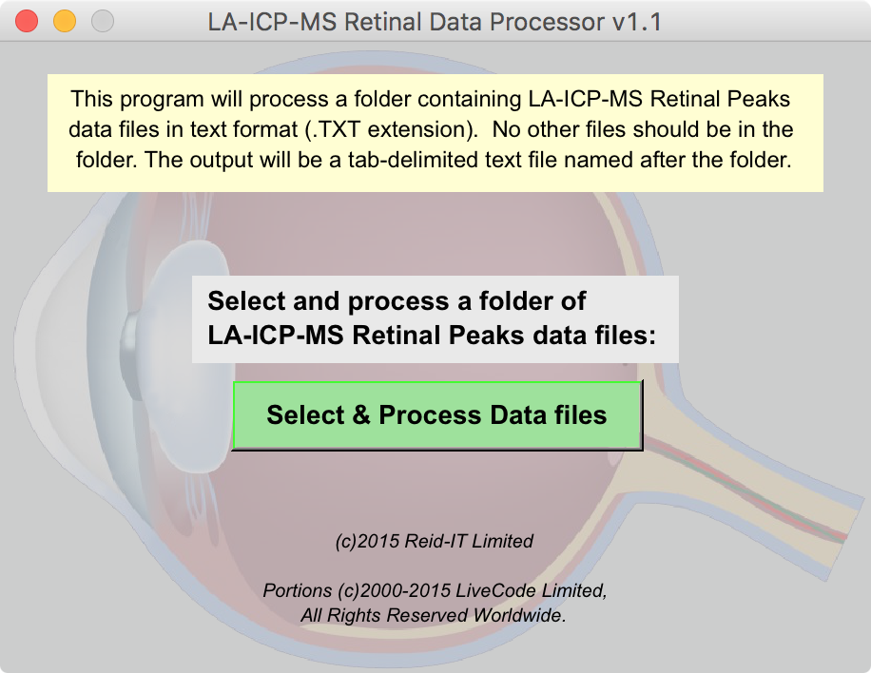
LA-ICP-MS RDP (LiveCode, 2015)
Merges a series of text output reports from curve-fitting software into compound spreadsheet
Involves identifying genuine peaks from false signals
Data is from retinal tissue samples looking for Zinc & Copper relevant to AMD condition

Slide 28
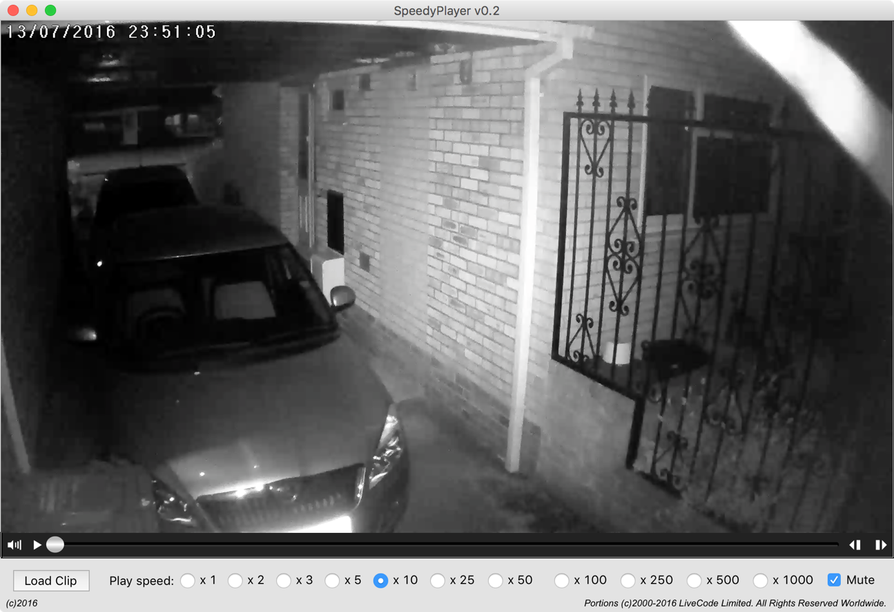
SpeedyPlayer (LiveCode, 2016-current)
Video player (Mac & PC)
1st use of non-QT video
Very high speed playback for rapid reviewing of security camera footage
Took 30 mins to get first release fully operational

Slide 29
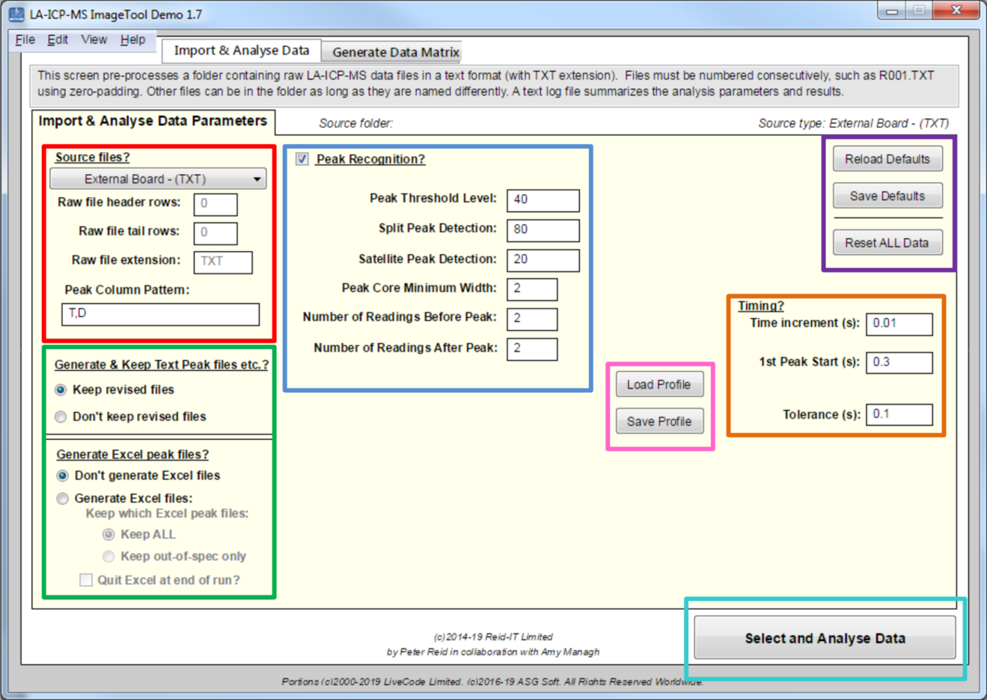
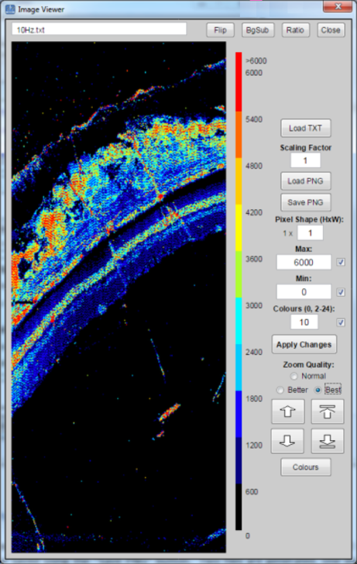
LA-ICP-MS ImageTool (LiveCode, 2016-current)
Rapidly generates images from LA-ICP-MS data
Locates peaks in raw data and uses them to segment the data and convert it to a matrix of colour coded pixels
App processes baseline separated peaks from the latest generation of low-dispersion LA systems, can be applied to rastered imaging with other LA platforms
Peak recognition can be used in single cell and single particle ICP-MS examples
App used for imaging of zinc in a stained section of rat retina tissue at lateral resolutions down to 1 mm
Less than two minutes to convert raw data into a 60,000 pixel image
https://www.reid-it.co.uk/downloads/down_la_icp_ms_it.htm

Slide 30
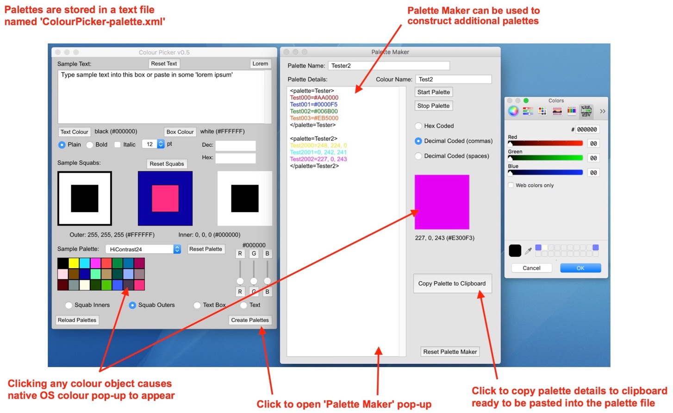
ColourPicker (LiveCode, 2017-current)
Provides a standalone colour picker
Experiment with different colour combinations
Provides a native colour pop-up
Simple text-based palette files
Supports hex and decimal colour codes
For Macs, PCs and Linux
https://tinyurl.com/y6myhuxc

Slide 31
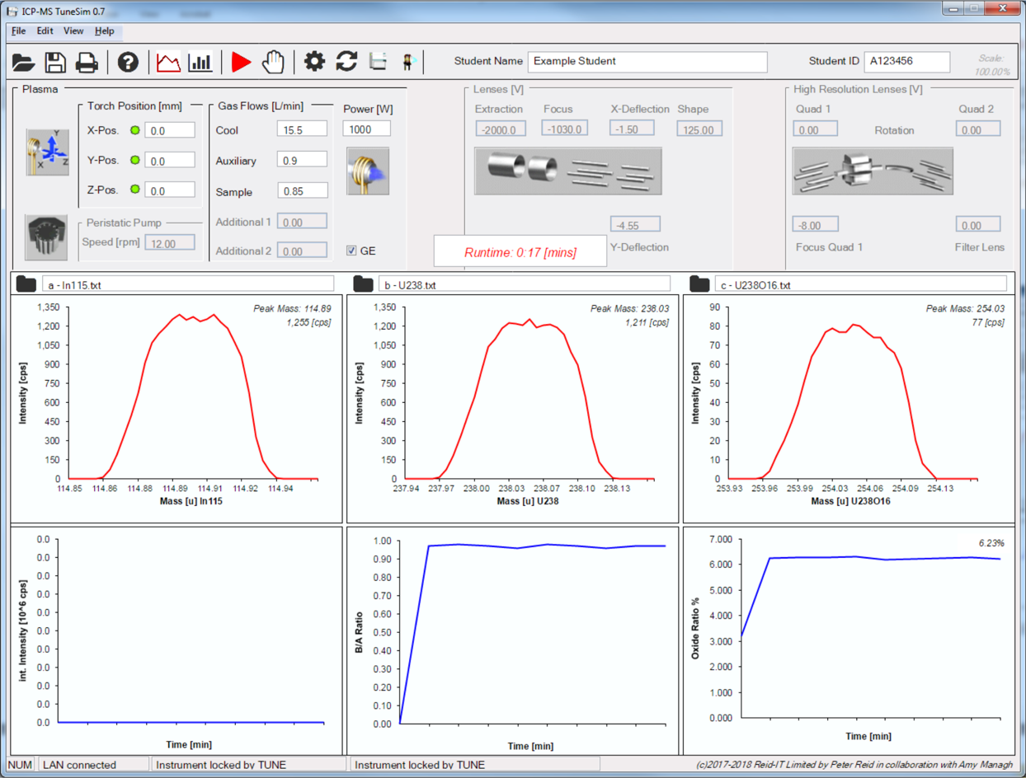
ICP-MS Tuning Simulator (LiveCode, 2017-current)
Simulates tuning of an inductively coupled plasma mass spectrometer (ICP-MS)
Based on optimization data collected using a sector- field instrument
Students can adjust parameters, such as the torch position, gas flows, radio-frequency power, and guard-electrode state, while observing the signal for three “measured” variables in real time
Used by students to supplement theory in an Atomic Spectrometry course
Students learn about key components of the instrument and how multiple factors may need to be balanced when performing optimization
https://www.reid-it.co.uk/downloads/down_icp_ms_tunesim.htm

Slide 32
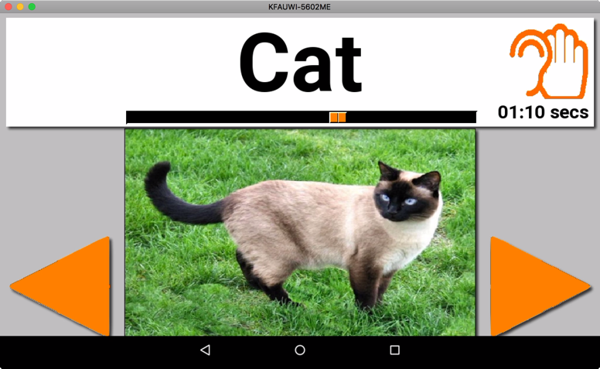
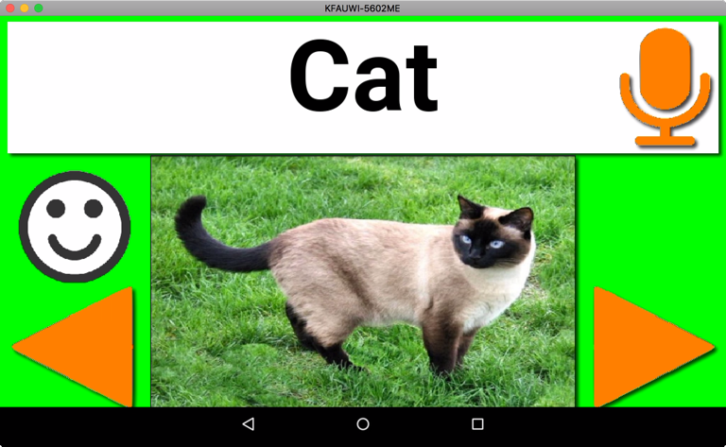
Aphasia Trainer (LiveCode, 2018-current)
Word recognition and pronunciation training for aphasia sufferers
Runs on cheap Android tablets and phones such as Amazon Fire 7in tablet
User sees words with pictures and tries to say them
App judges whether user has said the right word
Uses word packs to allow personalised vocabulary
Can include videos showing mouth movement

Slide 33
BingoBalls (LiveCode, 2018-current)
Old favourite bingo
Little tweak to basic rules to play using virtual meetings technology (Zoom, Teams, Skype, etc)
The “Bingo Balls” app has been developed to be used with normal or virtual groups
The app can use different computerised voices
Phrases can be replaced with a list of your own choices to tailor them to the interests of your group of friends or family
https://www.reid-it.co.uk/downloads/down_bballs.htm

Slide 34
MyCoins (LiveCode, 2018-current)
Developed to catalogue a substantial collection of over 950 British coins
Variant can be used for coins from anywhere
Primary database is a CSV text file
Items can have two primary pictures, obverse/front and reverse/back of an item
https://www.reid-it.co.uk/downloads/down_mycoins_uk.htm

Slide 35
GridComms (LiveCode, 2018-current)
Tablet / mobile phones app allows a person with limited or no speech to communicate by playing commonly used short phrases
Concept based on solution for Graham who suffered from a massive stroke leaving him almost completely paralysed, unable to speak
Developed to work on cheap Android-based tablets and mobile phones ($75/£50)
Typical user likely to be elderly, disabled or both and have limited funds
Also, these users will need a bespoke solution highly tailored to the particular individual
https://www.reid-it.co.uk/downloads/downgc.htm

Slide 36
MeSyProg (LiveCode, 2020-current)
Help patients who would like to receive medication once per month
Helps GP and pharmacy synchronise medications reducing delivery to once per month
Medication is supplied as whole packs, typically with 28 tablets per pack
GP and/or the pharmacist has to pay for medication earlier than is desirable, impacting on cash-flows
Available for download, free to use.
https://reid-it.co.uk/downloads/down_medsync.htm

Slide 37
Cu3a Event Bookings (LiveCode, 2021-current)
Helps local special interest groups manage event bookings
Helps to manage sporadic email bookings
Generates multiple email reminders

Slide 38
Fast Find (LiveCode, 2021-current)
Proof-of-concept use of inverted file index for high speed record look-up
Search results displayed as user types each character of their search pattern
Supports simultaneous multi-field search

Slide 39
CalendarMaker (LiveCode, 2021-current)
Manages calendar events for approx. 90 special interest groups
Events are specified in the form “2nd Tuesday of the month”, “Last Friday of the month”, etc.
Generates weekly and monthly events calendar
Generated calendars are in HTML format suitable for insertion into web site
Also generates different format monthly calendar for monthly newsletter
Available (by request) and free to use.

Slide 40
Towers of Hanoi (LiveCode, 2021-current)
Based on classic game
Commonly used as example of programmed recursion
In auto mode, computer plays game
Includes interactive mode so user can play the game separately
Available for Windows PC, Macintosh & Linux Mint
Available (by request) and free to use.

Slide 41
Assorted Utilities (LiveCode, 2000-current)
LiveCode is often used for a variety of small utilities, focussed on some simple requirement that’s needed for a brief period and then discarded afterwards:
Variety of mini and partial apps, often run within IDE, not made into standalone apps
Mainly concerned with data capture, conversion, manipulation, and aggregation
Minimal / basic user interfaces
Single platform, typically Mac only
Almost throw-away
Library collections, reusable code fragments
©2016-21, Peter Reid
41

Slide 42
the Answer to Life, the Universe and EVERYTHING*
Slide 42!
LiveCode
well maybe not EVERYTHING, but close!
* The Hitchhiker’s Guide to the Galaxy, Douglas Adams, 1978

Slide 43
Summary
LiveCode (Revolution, MetaCard) effective for wide range of uses
Developing in LiveCode is very quick
LiveCode is rewarding to use, both in terms of 🏧 and 😀
Old code can be reactivated and updated
LiveCode stands the test of time!
Is it “perfect”?
no, as they say “Pobody’s Nerfect!”
but it’s highly usable & getting better over time!
18 years and counting.......................................
22 years and still counting.........

Slide 44
The End
http://www.reid-it.co.uk/downloads/downlc.htm
http://tinyurl.com/zelqb6j

